Slide 1
Chemistry and Computers (Computational Chemistry)
Computational chemistry is a branch of chemistry that uses principles of computer science to assist in solving chemical problems
Databases of chemical compounds are either publically accessible or proprietary
It is now possible to search for structures and properties of compounds in these databases containing millions of compounds within seconds.
A recent development is creation of databases of billions of virtual molecules which do not exist ,but can be synthesized.
MyMolDB is a micromolecular database solution based on the Python scripting, a system that can handle up to a million structures easily.

Slide 2
Computer Representations of Chemical Structures
Computational representation of 2D and 3D structures.
ChemDraw and ISIS/Draw are two easy to use programs for drawing 2D structures
Structures are stored in databases as molecular graphs (Graph theory).
Graph is abstract structure containing nodes (atoms) connected by edges (bonds).

Slide 3
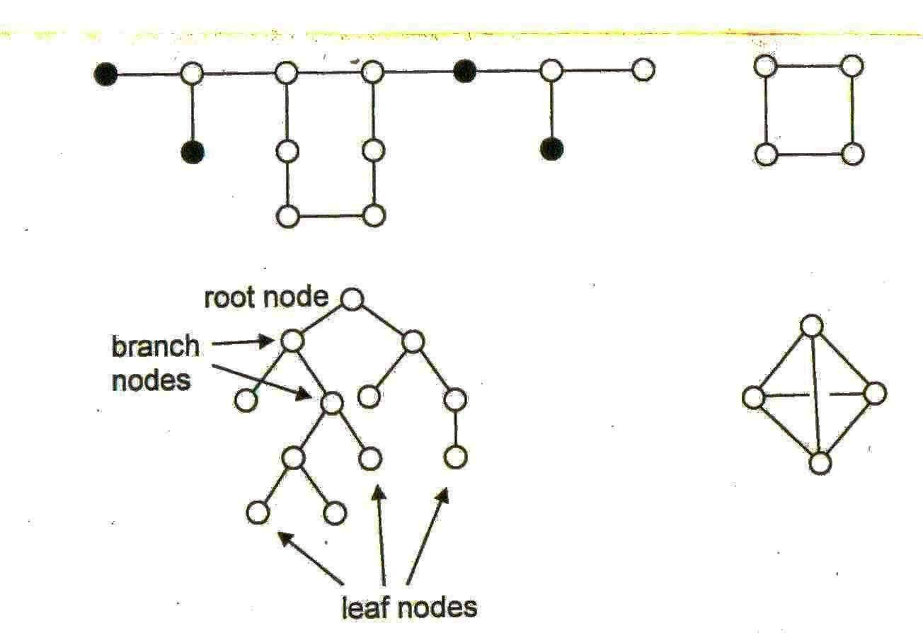
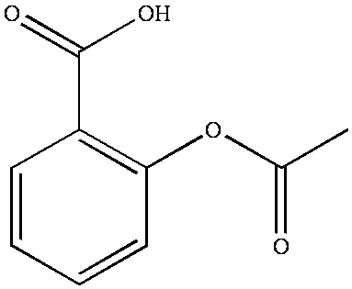
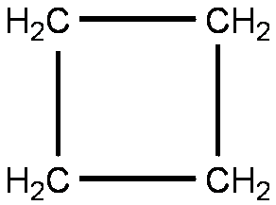
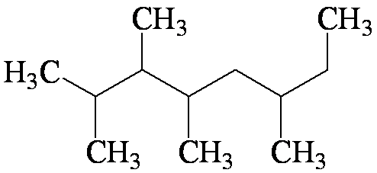


Slide 4
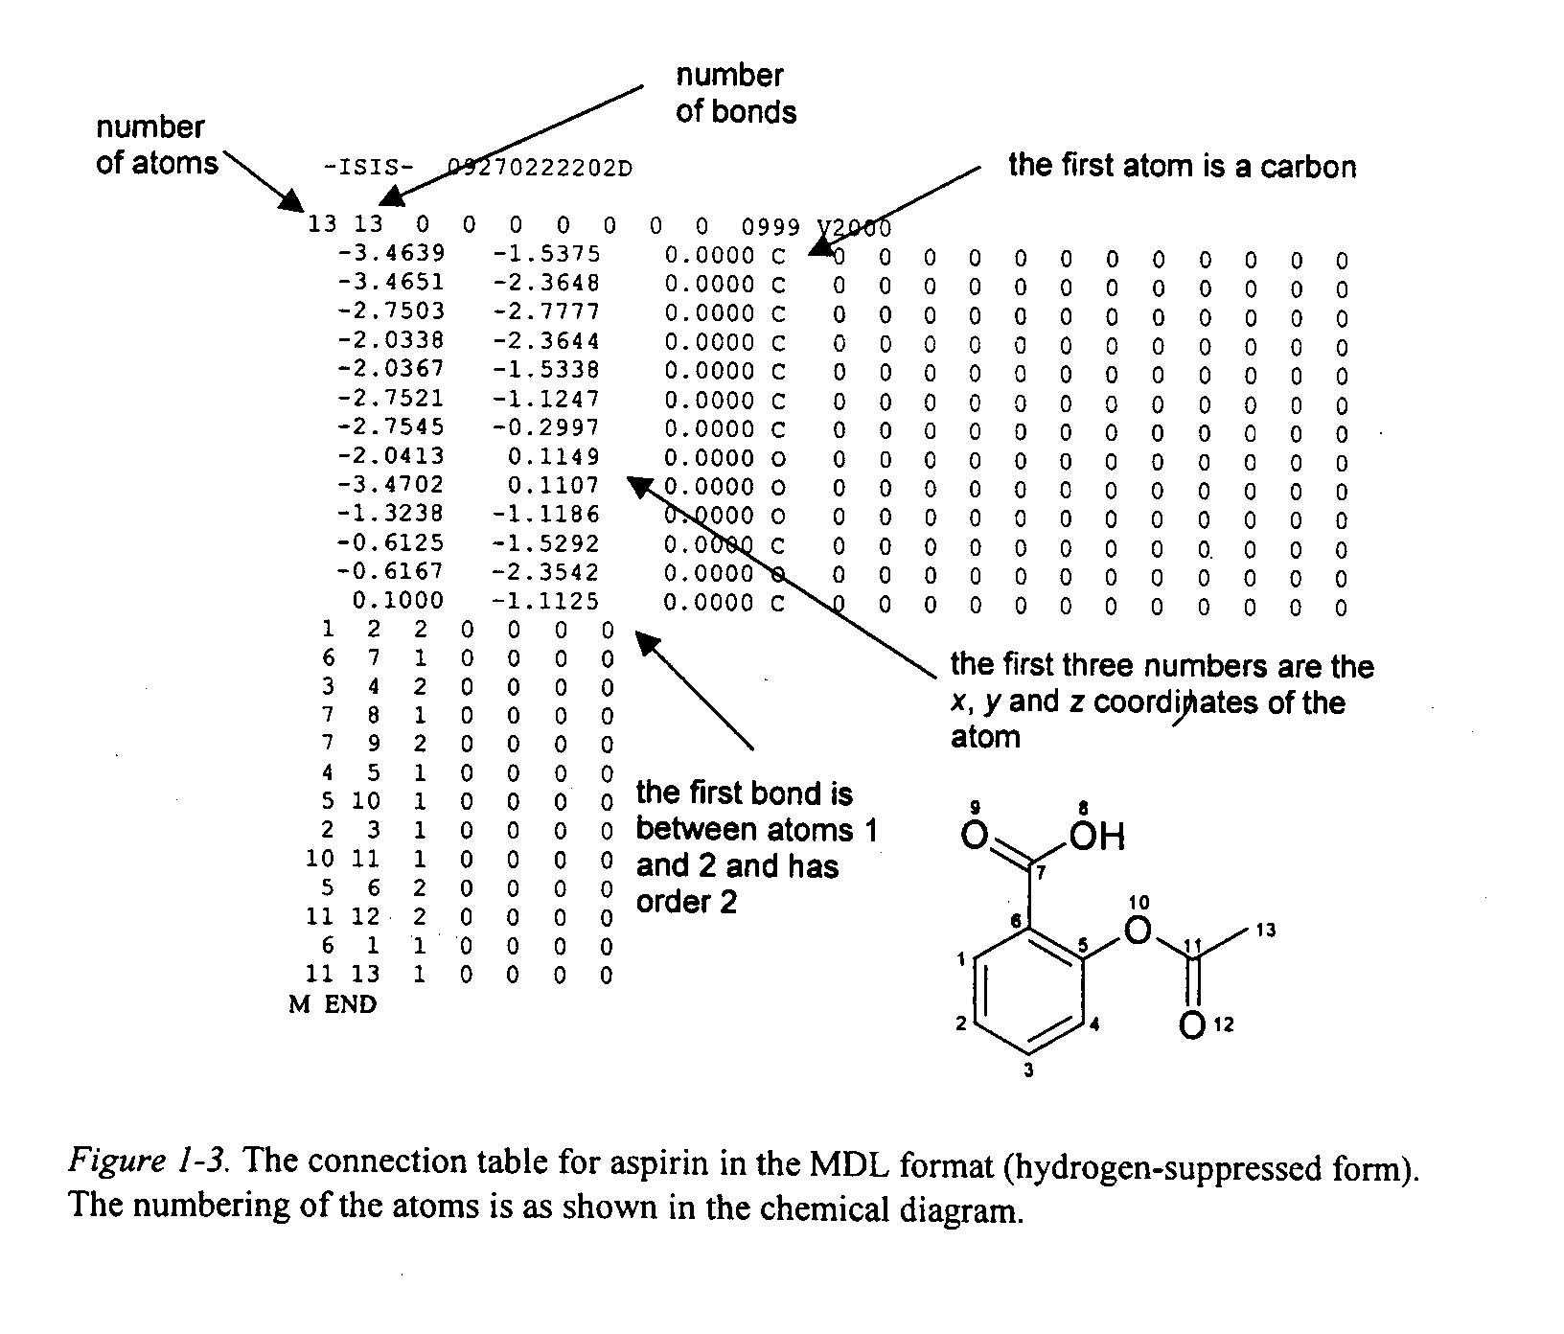

Slide 5
Line Notation
1.Wiswesser line notation (WLN)
2. SMILES(Simplified Molecular Input Line Entry Specification) Weininger, 1988)
(more simpler; hydrogen suppressed))
C=Methane; CC=Ethane
CC( C ) C =2-methyl propane
CC(=O) O =acetic acid; c1ccccc1=benzene;
= double bond; # triple bond;@=absolute stereochemistry at chiral atom; cis-trans by slashes e.g. trans butene C/C=C/C and cis –butene C/C=C\C

Slide 6
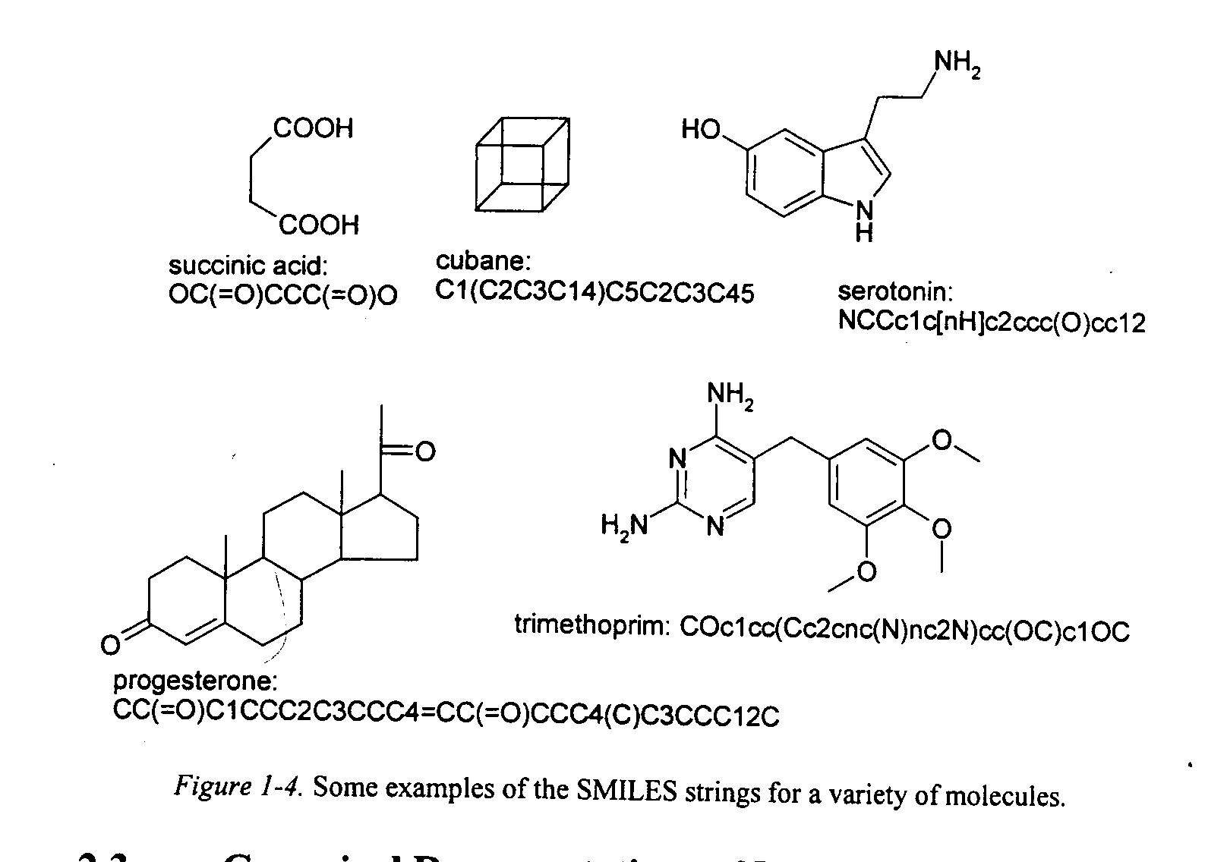

Slide 7
SMILES NOTATION
CANGEN, algorithm has been developed to generate a unique SMILES string for each molecule
Canonical SMILES for aspirin, CC(=O)Oc1ccccc1C(=O)O
IUPAC has developed CML (Chemical Markup Language) for exchanging information over internet.

Slide 8
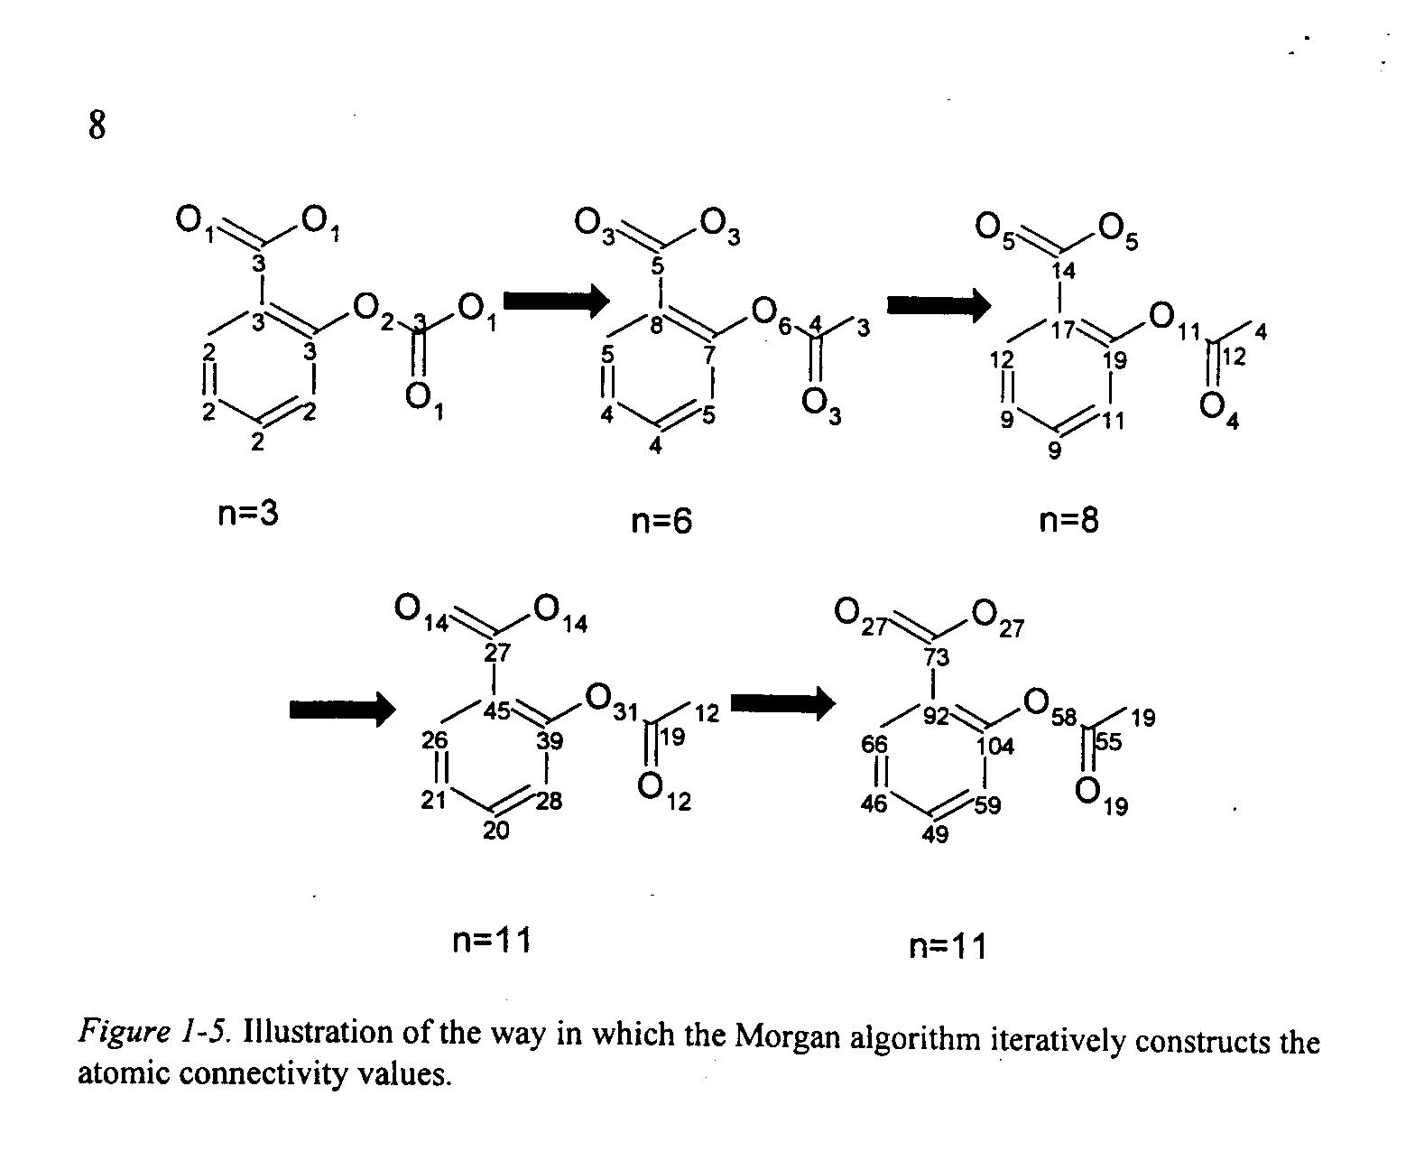

Slide 9
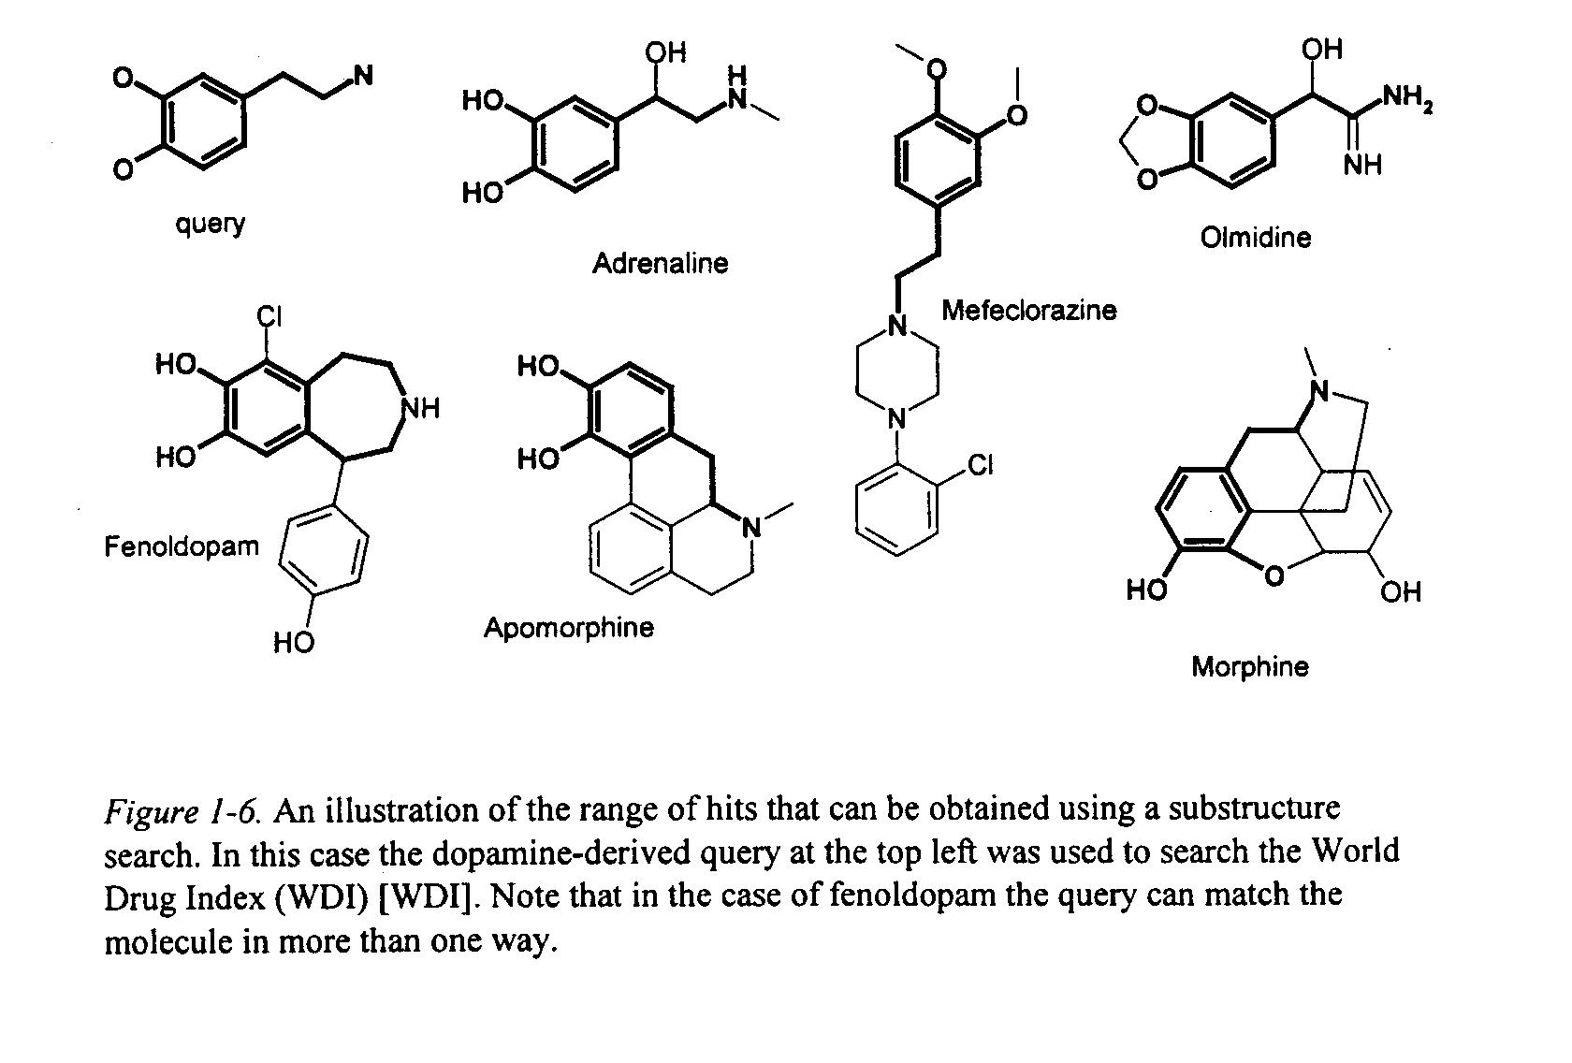

Slide 10
CHEMSPIDER
Chemspider is a free chemical structure database
provides fast access to over 28+ million structures, their properties and associated information.
Integrates and links compounds from more than 400 data sources.
chemical data from a single online search.
Watch ChemSpider helps videos with subtitles in 7 languages ,Chinese ,German , Hindi ,Japanese Russian ,Spanish and Turkish

Slide 11
Thank you
Learn Computer for technical writing

